Slide 1
ESPNGen
Chris Pillion
John Zavidniak
Akshat Kambli

Slide 2
Use Case: Journalist Signup
- Walk through signing up as a Journalist.

Slide 3
Page and PageAction
Our application can be thought of as similar website, broken into a number of Pages.
Each Page has a method to display its content, and actions which can be performed by the user.
Controller holds current page being viewed by the application user.

Slide 4
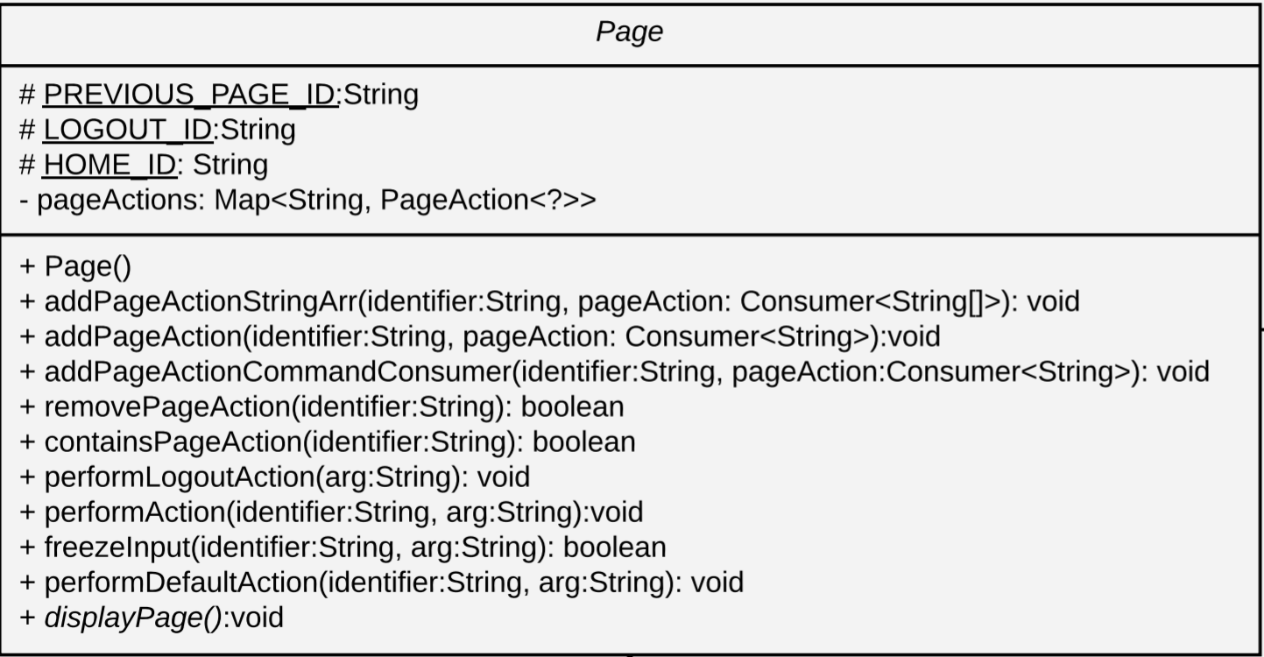
How Page works

Slide 5
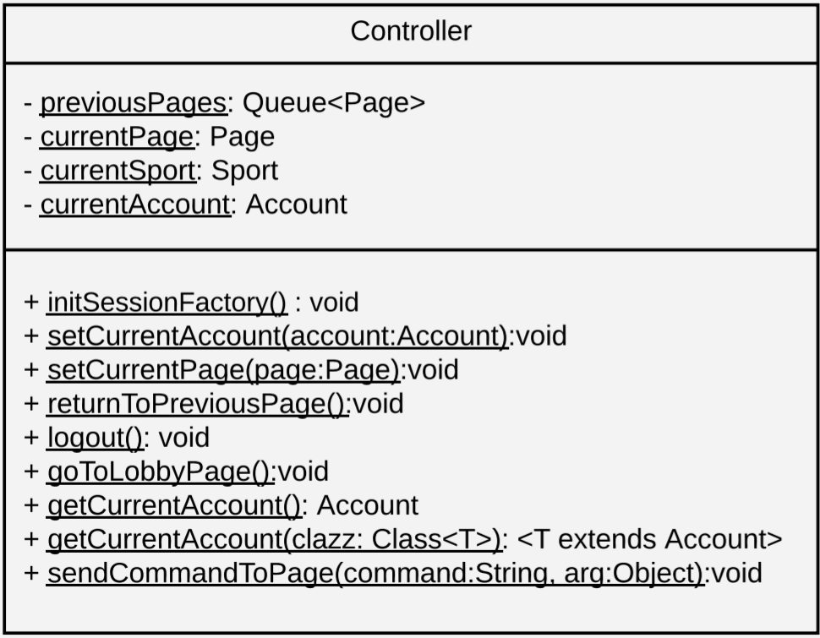
How Page works cont.

Slide 6
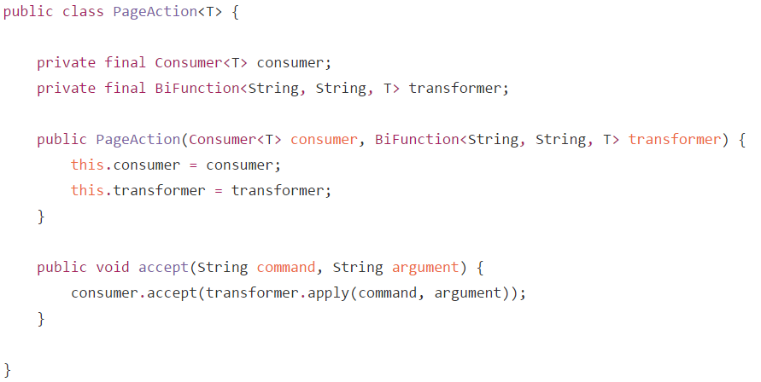
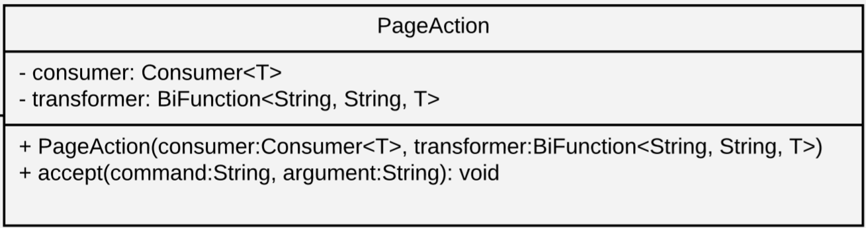
PageAction class
Overcame the problem of
each action potentially
accepting a different argument type.

